Slide 1
Database Management CSE303
Student Performance monitoring system Group-4

Slide 2
GROUP MEMBER
Misbahur Rashid – 1721911
Rafid Al Ahsan – 1722006
Md.Musfiqur Rahaman – 1721684
Sadia Afroz Alma - 1730407
Md.Sakimuzzaman – 1721527
Puja Bhowmik – 1730791
Elan Md Taseen - 1831050

Slide 3
INTRODUCTION
The Student Performance Monitoring System (SPMS) focuses on performance monitoring of student’s continuous assessment and examination scores in order to predict their final achievement status upon graduation.
The main goal of this project is to find the systemic problems and limitation we have in our current system in few areas and how can we improve it. The aim of our project is to design, build and deliver a developed software that we believe will help universities everywhere to promote a more productive and effective way of evaluating students. The faculties can input the COs for each of their students so that the system can map the COs to PLO accordingly. We also analyze individual processes that take place under the current system of monitoring student performance and the concerns and problems with those process from start to finish.

Slide 4
Project analysis slide 2
Rich Picture
ERD & Relational Schema
SPMS
Six Element Analysis
Normalization
Process Diagram
Data Dictionary

Slide 5
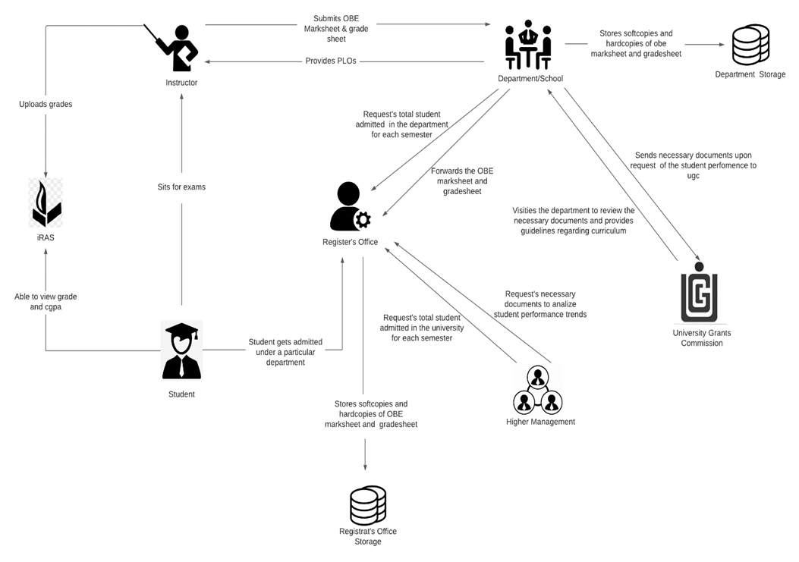
RICH PICTURE(AS-IS)

Slide 6
SIX ELEMENT (AS-IS)

Slide 7
PROCESS NAME
Student sits for exam
Student are able to view grades, CGPA and download transcript
Instructors uploads grades to IRAS
Instructors produce OBE mark sheet and grades sheet and submits it to the department
Map Course Outcomes (COs) to Program Learning Outcomes(PLOs)
Student gets admitted under a particular department
Request for review and change of grades
View Records OBE Mark sheets and Course Assessment Reports

Slide 8
SIX ELEMENT (AS-IS)
Process | System Roles
 | Human | Non-Comp Hardware | Computing Hardware | Software | Database | Network & Commination
Student sits for exam | Instructors 1) Prepare question according to the mapped COs. 2) Give a particular time and date for the exam 3) Prepare SODs and invigilators Students 1) Attempt the examination | Stationery 1) Pen and paper for writing. 2) Compass, ruler and other stationery for drawing diagrams Chairs and Table 1) For using during exam. Classroom 1) A space for conducting the exams Stapler 1) For attaching all the extra paper, rough work and answers | Computer/ Laptop 1) Some courses require a computer for coding or open book exam. Calculators 1) Some exams require the use of calculators Printers & photocopy machine 1) Instructors use it for printing question papers | Microsoft Word 1) Typing the question and generating a printable pdf. Operating System 1) Any OS may be used. e.g. Windows, MacOS. Adobe Acrobat Reader 1) For viewing the question paper in pdf format | Microsoft Excel 1) Used for storing exam marks and calculating final grade | Internet 1) Used by students during open book exam

Slide 9
Process | System Roles
 | Human | Non-Comp Hardware | Computing Hardware | Software | Database | Network & Commination
Student are able to view grades, cgpa and download transcript | Student 1) Students have to login to iras by entering the student id and password 2) Select a specific semester 3) View grades for specific semester 4) Click on the transcript button to download a copy of transcript | Paper 1) Used for printing and keeping a hardcopy of transcript | Computer/ Smart Phone 1) Used for accessing iras. Printer 1) For printing the transcript | iRAS 1) Provides user interface for view grades and download transcript. Browser 1) Any browser an be used to access iras. e.g. edge, chrome, Firefox Adobe Acrobat Reader 1) For viewing the transcript which is in pdf format. Operating System 1) Any OS may be used. e.g. Windows, MacOS. | iRAS database server 1) iras database server is used for storing and receiving student grade information in iras | Internet 1) Internet is required for accessing iras

Slide 10
Process | System Roles
 | Human | Non-Comp Hardware | Computing Hardware | Software | Database | Network & Commination
Instructors uploads grades to iras | Instructors 1) Instructors types in user id and password for logging into the system 2) The instructor clicks to the submit grade section and is taken into the grade submission page 3) The instructor selects grade for each of the student 4) Clicks on the submit button to submit the grades |  | Computer/ Smart Phone 1) Used for accessing iras and submitting the grade | iRAS 1) Provides user interface for submitting the grades Browser 1) Any browser an be used to access iras. e.g. edge, chrome, firefox Operating System 1) Any OS may be used. e.g. Windows, MacOS | iRAS database server 1) iras database server stores all the grades | Internet 1) Internet is required for accessing iras and submitting the grades

Slide 11
Process | System Roles
 | Human | Non-Comp Hardware | Computing Hardware | Software | Database | Network & Commination
Instructors produce OBE marksheet and grades sheet and submits it to the department | Instructors 1) Instructor takes quizzes and exam 2)Checks the exam script 3) Records the mark for each exam in an excel sheet 4) Calculates the final grades and 5) Calculate total marks received for each CO 6) Declare if a student has achieved a specific CO 7) Declare if a student has received a PLO for a related CO 8) Make a verdict and analysis of how many students were able to receive a certain CO and PLO | Paper 1) Used for storing hardcopies of OBE marksheet | Computer 1) Computer is used for making softcopies of OBE marksheets Printer 1) To print the hardcopies of the OBE marksheet and grade sheet | Microsoft Excel 1) Used by instructors to calculate the PLO and CO achievement | Department Storage 1) A hardcopy of OBE marksheet and grade sheet is stored in the department storage Register’s Office Storage 1) A hardcopy of OBE marksheet and grade sheet is stored in the register’s office storage | Internet 1) Online platform such as- google sheets may be used for producing OBE marksheet

Slide 12
Process | System Roles
 | Human | Non-Comp Hardware | Computing Hardware | Software | Database | Network & Commination
Instructors produce OBE marksheet and grades sheet and submits it to the department | 9) Sends the final version of OBE marksheet to department office Department 1) Receives a copy of the OBE marksheet and grade sheet from the instructors 2) Stores a copy of the OBE marksheet and grade sheet in department storage 3) Sends a copy of the OBE marksheet to the register’s office Register’s Office 1) Receives the OBE marksheet from department 2) Store the OBE marksheet in register’s office storage

Slide 13
Process | System Roles
 | Human | Non-Comp Hardware | Computing Hardware | Software | Database | Network & Commination
Map Course Outcomes (COs) to Program Learning Outcomes (PLOs) | UGC 1) Provides guide line to the department about the curriculum Department 1) Comes with the PLOs 2) Sends the PLOs to the instructor Instructor 1) List the course content and course outcome 2) Maps the course content to the COs 3)Maps the PLOs 4)Prepares question paper according to the COs | Pen and Paper 1) Used for brainstorming and rough works | Computer/Smart devices 1) Course coordinators use computers to make softcopies of course outcomes (COs) Printers 1) Used for print hardcopies of course outcomes (COs) | Microsoft Word 1) Course coordinators use MS word for making course outline and course assessment report with COs mapping to the PLOs |  | Internet 1) Internet is used to communicate with ugc and other stakeholders to discuss topics related mapping COs and PLOs

Slide 14
Process | System Roles
 | Human | Non-Comp Hardware | Computing Hardware | Software | Database | Network & Commination
Student gets admitted under a particular department | Student 1) Fills up the admission form for taking admission under a particular department 2) Receive an email regarding successful admission form submission Register’s Office 1) Receives the admission form 2) Analyze the admission 3) Check if the student fulfills all the requirements for getting admitted 4) If the student fulfills all the requirements then admit the student under the requested department. | Paper 1) Register’s office keeps a hardcopy of student information. e.g. student blood group, emergence contact number, address | Computer 1) Used for accessing iras and filling admission form Printers 1) For printing hardcopies of student information | iRAS 1) Provides user interface for filling the admission form Browser 1) Any browser an be used to access iras. e.g. edge, chrome, Firefox Operating System 1) Any OS may be used. e.g. Windows, MacOS. | iRAS database server 1) iras database server is used for storing all the admission information. | Internet 1) Internet is required for accessing the online admission form.

Slide 15
Process | System Roles
 | Human | Non-Comp Hardware | Computing Hardware | Software | Database | Network & Commination
Student gets admitted under a particular department | 6) Generate a student id number 5) Sends the total number of students enrolled in a semester under a particular department to the department. 6) Send the total number of students enrolled in the university to the higher management. Department 1) Request total student enrolled in the department 2) Receive information about total student enrolled in department Higher Management 1) Request total student enrolled in the university 2) Receive information about total student enrolled in department.

Slide 16
Process | System Roles
 | Human | Non-Comp Hardware | Computing Hardware | Software | Database | Network & Commination
Request for review and change of grades | Student 1)Request an Instructor for grade change by sending an application via email. Instructor 1)Receive a grade change mail from the student. 2)Check exam Papers and other assessment upon request. 3)If change needs to be made, then the instructor informs the department. 4) If not, end the process. Mail the student that his request has been denied. Department 1) Receives information regarding grade change of a specific student in a course. | Pen and Paper 1)used to note down key points or marks on the students’ answer sheets. | Computer/ Laptop 1) Used for sending email to the instructor | iRAS 1)Used by the Register office for changing the grade Operating System 1) Any OS may be used. e.g. Windows, MacOS. | iRAS database server 1) Update student grade data. Department Storage 1)Update student grade data. Register office’s Storage 1)Update student grade data. | Internet 1) Internet is needed to the mail a grade change request.

Slide 17
Processf | System Roles
 | Human | Non-Comp Hardware | Computing Hardware | Software | Database | Network & Commination
Request for review and change of grades | 2) Sends a request to the register’s office for grade change 3)Updates the OBE marksheet and grade sheet with the new grade and stores it in the department storage Register’s office 1)Receive a request from the department for the changing the grade of a student in a specific course. 2)Changes the grade of the particular student in the requested course. 3)Updates the register’s office storage with the new grade

Slide 18
Process | System Roles
 | Human | Non-Comp Hardware | Computing Hardware | Software | Database | Network & Commination
View Records OBE Marksheets and Course Assessment Reports | UGC 1. Inform the university head of a deadline within which OBE Marksheets, Course Assessment Reports and other documents are needed for quality inspection to make necessary improvements to degree programs. 2. Inform the university head if an UGC personnel will visit the campus or softcopies will suffice. 3. Visit university heads and relevant schools to receive the necessary documents and reports if that is what was informed. Department 1) Request to view records of OBE Marksheets, Course Assessment Reports to analyze students’ performance trends. | Paper and Pen 1)Used for noting/marking down key points of the report. | Computer 1) Used for viewing softcopies of OBE marksheet and grade sheet. 2) Used for send softcopies of OBE marksheet to the ugc officials. | Microsoft Excel 1) Used for viewing softcopies of marksheet Operating System 1) Any OS may be used. e.g. Windows, MacOS. | Department Storage 1) Used for retrieval of OBE marksheet and grade sheet when needed 2) Stores hardcopies and softcopies of OBE marksheet and grade sheet | Internet 1) Softcopies of OBE marksheet and grade sheet may be mailed to the ugc officials. 2) Online platforms such as google sheet may be use for displaying softcopies of marksheet.

Slide 19
Process | System Roles
 | Human | Non-Comp Hardware | Computing Hardware | Software | Database | Network & Commination
 | 2) Direct Department Staff to gather necessary documents, OBE Marksheets and Assessment report for a given time-period specified by UGC. 3) Receive the necessary documents gathered by the Department 4) Evaluate the need to change/ improve the department’s educational resources based on students’ performance trends. 5) Send necessary documents to ugc. Higher Management 1) Requests the register’s office to send records of OBE Marksheets, Course Assessment Reports to analyze students’ performance trends.

Slide 20
Process | System Roles
 | Human | Non-Comp Hardware | Computing Hardware | Software | Database | Network & Commination
 | Register’s Office 1) Receive a request from higher management for sending OBE marksheet and grade sheets. 2) Sends the requested OBE marksheets and grade sheets to the register’s office.

Slide 21
PROCESS DIAGRAM (AS-IS)

Slide 22
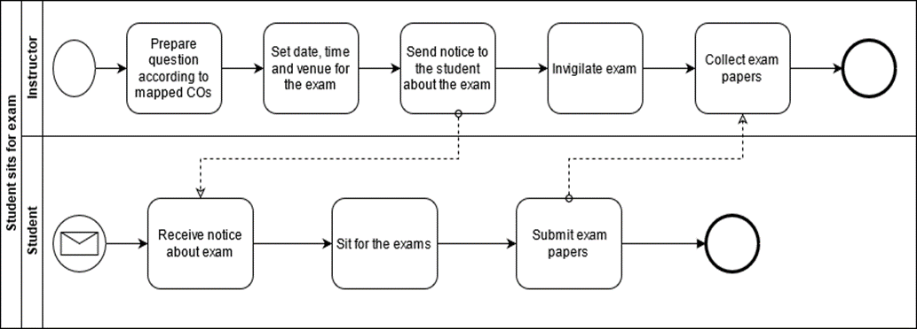
FIGURE 2.1 Process Diagram for Student Sits for exam

Slide 23
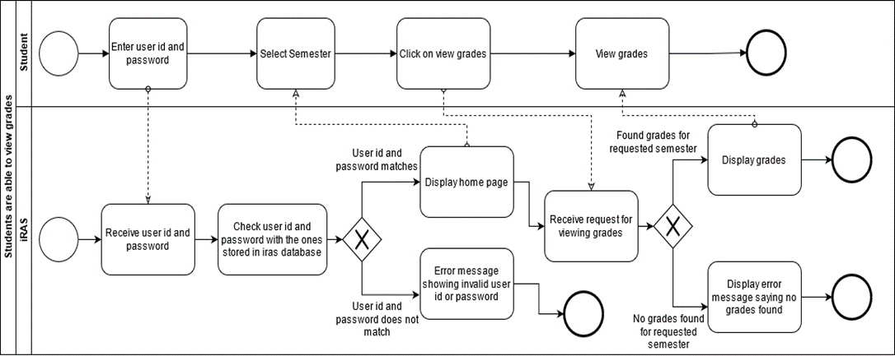
FIGURE 2.2 Process Diagram for Student are able to view grades and CGPA

Slide 24
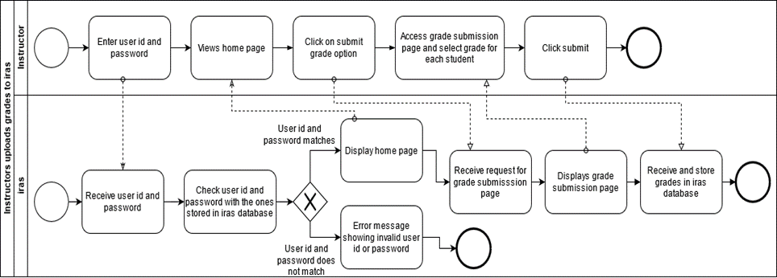
FIGURE 2.3 Process Diagram for Instructor uploading grade to iras

Slide 25
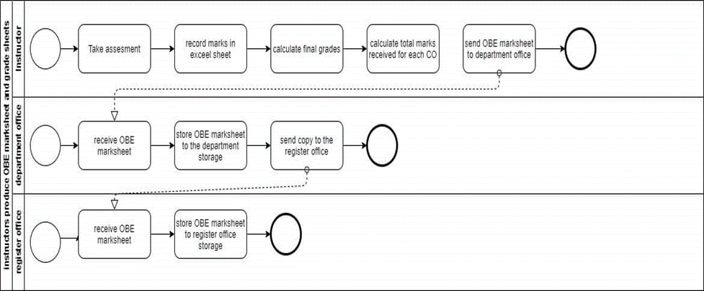
FIGURE 2.4 Process Diagram for Instructor produces OBE mark sheet

Slide 26
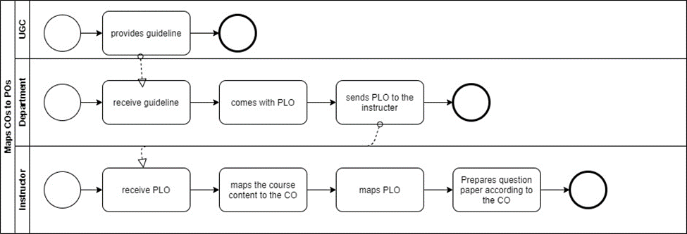
FIGURE 2.5 Process Diagram for Map COs and POs

Slide 27
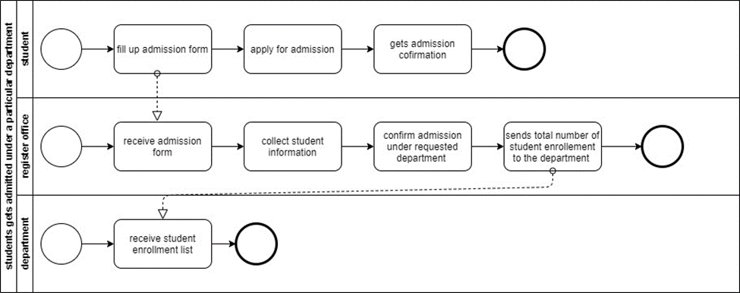
FIGURE 2.6 Process Diagram for Student gets admitted under particular department

Slide 28
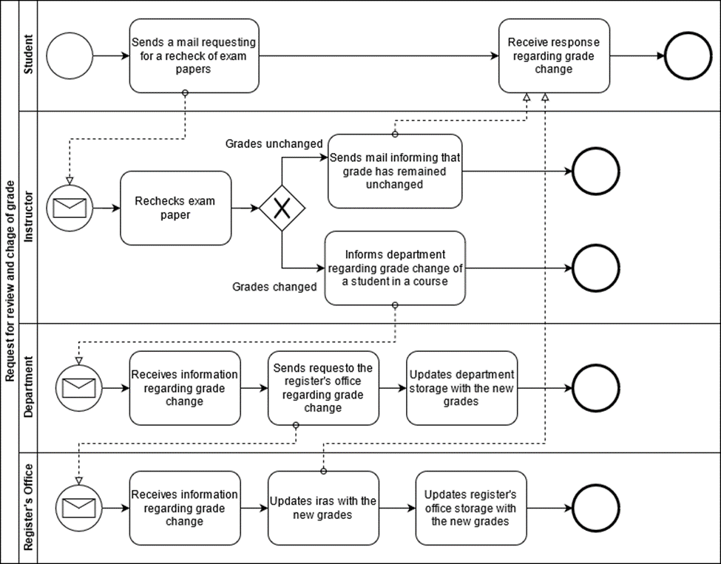
FIGURE 2.7 Process Diagram for request for review and change of grades

Slide 29
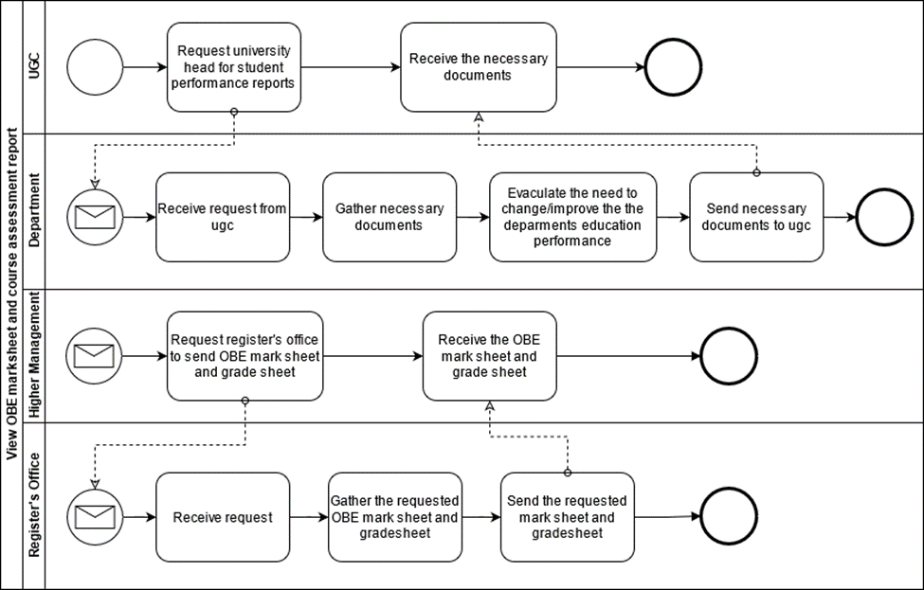
FIGURE 2.8 Process Diagram for view obe mark sheet and course assessment report

Slide 30
PROBLEM ANALYSIS

Slide 31
PROCESS NAME
Preparing a Course Assessment
Higher Management Viewing Individual Instructor Performance
Instructor viewing the CGPA and change the grade
Higher management and Instructor viewing OBE mark sheet and grade sheet
Students will be able to get grades from Department instead of Instructor
Higher Management & Instructor Uploading & Viewing PLOs/CO
Student viewing PLO & CO
UGC approves curriculum based on PLO and CO

Slide 32
PROBLEM ANALYSIS
Process Name | Stakeholders | Concern (Problems) | Analysis (reason of the problem) | Proposed Solutions
Preparing a Course Assessment | 1.Instructor 2.Student | Sending hardcopy And softcopy Students examination marks And course Assessment report to the register office store the info Time consumption And delay is prime limitation. Even after storing data in the register office store, if there is any need to see the information of any student or any course performance or a particular section of high management then It is very difficult to find these. | In our existing system higher management store assessment data manually As sending hardcopy and softcopy to the register office involve multiple persons and different processes, it could easily led to confusion, loss of important student report card. It also wastes unnecessary resources such as paper and printer. | We will create a system where Higher management will no longer have to wait for the registered office for searching particular student data. If higher management wants to find student data, specific course data, or find specific section-wise student data they can enter only student ID, Course ID, or Section ID in our new system. They will be able to see student performances in the graph shows. And they can download student information.

Slide 33
Process Name | Stakeholders | Concern (Problems) | Analysis (reason of the problem) | Proposed Solutions
Higher Management Viewing Individual Instructor Performance | 1.Department Head 2.Dean 3.Instructor | In our existing system higher management can’t see their instructor performance digitally. Higher management see only Instructor performance send by the hardcopy of the course wise student performance report. Higher Management can’t see how many quizzes and assignment they are taken, whether he is taking regular classes, whether he is giving exam papers properly, what is the result of the student in his section, what was the result of the last semester even under that faculty and what kind of project they are maintains for specific course and prepare a projects specification based on their course | In our exacting system higher management can only see Hardcopy for an individual instructor performance, but it's difficult for measuring a performance instructor by instructor, and it's also difficult comparing with previous semester performance because its hardworking and time consumption matter. It also wastes unnecessary resources such as paper and printer. | We will create a new system where Higher Management can see their Instructor Performance department wise, section wise, and course wise. Higher Management can download instructor performance data with graphs or charts. Then they can easily compare to each other and also compare with previous semester result in the same course. After download data Higher Management can see their performance like how many quizzes and assignment they are taking, whether instructor attend the class regularly, also see instructor class performance and class performance feedback by the student after faculty evaluation

Slide 34
Process Name | Stakeholders | Concern (Problems) | Analysis (reason of the problem) | Proposed Solutions
Instructor viewing the CGPA and change the grade | 1.Instructor 2.Student | In our existing system without the Higher Management, the faculty cannot see any student's CGPA and grade sheet. They only know about the courses they have taken. Even once they upload the grade to the system, they cannot change it later. If a student's grade changes or applies for a change, the instructor has to help the Register Office and Department Head. And it takes the permission of the obsessed department head to change the grade | Now, instructor can’t see any student CGPA and grade sheet and also If a student feels that his or her grade has not been returned or correct, the student will apply along with the instructor. After Application Instructor Contact Department Head Than They Can Check the Script Again. If change is another grade then department head request to Register Office for Change The Grade, It's a Long Term and Hard Process Also its Time Consumption process. | We will create a new system where Higher Management and instructor can see the student CGPA and Grade sheet using student ID in this case instructors and students should be in the same department. And also we will create a system where higher management and instructor can change the grade easily getting application from student after checking script with department head and controller of examination. After. And instructor get permission to resubmits the grades easily using our new system.

Slide 35
Process Name | Stakeholders | Concern (Problems) | Analysis (reason of the problem) | Proposed Solutions
Higher management and Instructor viewing OBE mark sheet and grade sheet | 1.Higher management (HM) 2.Instructor 3.Department 4.Dean/Vc | The current process of requesting the head of the department to view records for analysis and inspection can result in delays due to various problems in communication. Since the OBE Marks sheets course assessment reports and other necessary documents are only saved in softcopies (Without database management) and hard copies, it can get tedious and time-consuming to retrieve them when needed. | Due to being a hardcopy, when the Higher management wants to see each course, section, and department wise OBE mark sheet and course assessment then a lot of trouble to maintain this kind of documents, and it is also very difficult to analyze by looking at the hard copy so that the data is likely to be wrong and lost and when these data are compared with any previous data it becomes more difficult. It also wastes unnecessary resources such as paper and printer. | We will create a new system where Higher Management and instructor can see the OBE Mark Sheet, Course Assessment using their ID (Only those to whom Higher management will give permission will be able to see) The system that we will build be there the mark sheet and course assessments will be according to the section, course, and department, and they can download them as needed.

Slide 36
Process Name | Stakeholders | Concern (Problems) | Analysis (reason of the problem) | Proposed Solutions
Students will be able to get grades from Department instead of Instructor Higher Management & Instructor Uploading & Viewing PLOs/CO | Department Instructor Student Higher Management (HM) Department | We don't have the option to grade someone else instead of the Instructor in our system. If for some reason an instructor cannot give a grade If there is an instructor leave or something tragic happens then there is no option to continue the semester and submit a grade, unless the department manages it. In our existing system Higher Management (HM), Department Head, Dean/VC and instructor see only hardcopy PLOs and Co achievement, but its time consuming when they want to check it manually. There are many students in one section and every course has many sections and each department has many students, so a lot of student information is not possible to check manually. In this case, there is a possibility to lose data. | If necessary, if an instructor is on leave, then the whole matter has to be handled by the department Instead, another instructor has to be appointed and he has to explain the whole process again, it's difficult to manage in a short period of a semester. The current system does not support Viewing PLOs and CO achievement. Due to which no one Instructor, Higher Management cannot see the POL & Co Achievement and student performance | We will create a new system where the Department Head can see the performance of the students and give them a grade for Emergency Situations. Based on their PLO & co achievement and OBE mark sheet in the Previous semester We will create a new system where Where instructors can upload Plo & Co reports, all of the higher management and instructors can see and download the data. They will be able to view this data using input Student id to the system and see Plo & co achievement of any specific student, course-wise, and section-wise.

Slide 37
Process Name | Stakeholders | Concern (Problems) | Analysis (reason of the problem) | Proposed Solutions
Student viewing PLO & CO UGC approves curriculum based on PLO and CO | 1.Student 1. Higher Management (HM) 2. UGC | In our existing system Student cannot see our PLOs and Co achievement. They cannot even see the hardcopy. HM needs to send the curriculum booklet manually. HM needs to send the updated Curriculum to the Department every time. | It is important for every student to see their Plo and co-Achievement, what course they are doing, it is important to know what did they achieved and what issues need to be improved. But it is not seen in our existing system now. It will take time for the UGC to receive the Curriculum booklet and process the information. It is a hassle to send manually every time the curriculum is updated | We will create a new system where Students will be able to see and download the file and they will be able to view their Plo & Co achievement and compare with the other Course. We can transfer the curriculum in our new system by which it could be accessed easily by the members and it also could be edited real time by the HM and updated instantly whenever changes are required by the UGC.

Slide 38
RICH PICTURE (TO-BE)

Slide 39
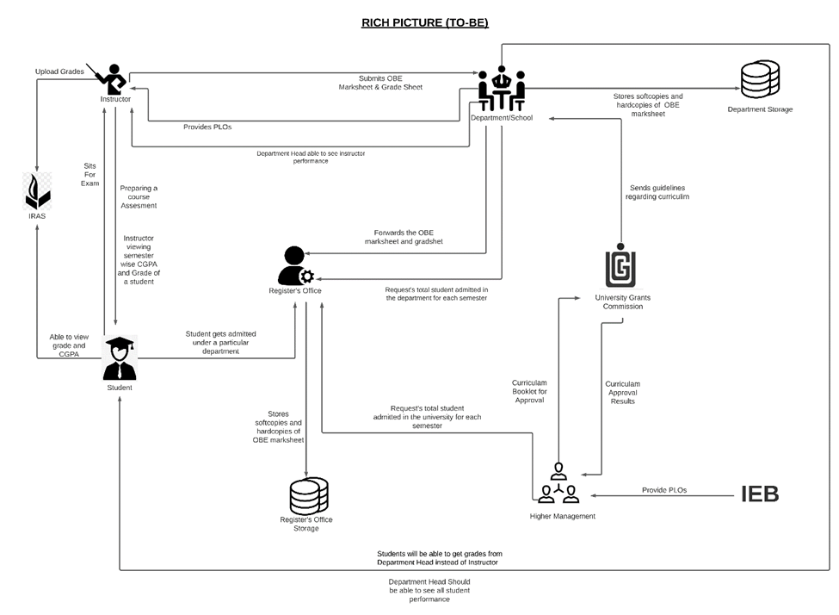
RICH PICTURE (TO-BE)

Slide 40
SIX ELEMENT (TO-BE)

Slide 41
PROCESS NAME (TO-BE)
Preparing Course Assessment of Instructor
Instructor Able to see the result of another courses of a Student
Students will be able to get grades from Department instead
UGC approves curriculum based on PLO and CO
Department Head able to see all instructor Performance
Higher Management and Instructor viewing OBE mark sheets and grade sheet
Instructor viewing CGPA and change the grade
Student viewing PLO & CO

Slide 42
SIX ELEMENT (TO-BE)
System Process | Human | Non-comb Hardware | Computing Hardware | Software | Database | Network and Communication
Preparing Course Assessment of Instructor | Instructor: 1)Log in to a “New System”. 2) Instructor will be shown the courses they have/had for every semester under “Semester” Tab. 3)Select course (section and thereof). 4)Create (quiz/ exam/ project) 5)For each student, each student’s score for each question. 6) Upload the Assessment report for the students. Student: 1)Login to the “New System”. 2)Goes to desired course. 3)Click on “Course Assessment’ 4) Download it. | Google Forms: 1)Used for recording a student’s remote response to the questions. | Computer: 1)Used for accessing the “New System”. Printer: 1)Printout the softcopy of Assessment report. | New System Faculty frontend: 1)Provides user interface for the faculty to enter student assessment data | Google Classroom: 1)Import assessment data from google forms(or classroom, depending on their API), manually or automatically | Internet: 1)New System is a fully online web application: all preparing and requests thereof are sent through the internet. Email: 1)Email is the primary method of notifying the students about major assessment

Slide 43
System Process | Human | Non-comb Hardware | Computing Hardware | Software | Database | Network and Communication
Instructor Able to see the result of another courses of a Student | Instructor: 1.Login to New System. 2. Search that specific student's id. 3. See the grades of other courses for intended semester but only his/her(Instructor) Department. Register Office: 1.Access New System. 2.View Students grades of other courses if and when it’s necessary | Pen and Paper: Note down the grade if needed. | Computer/Phone: 1.Used for accessing New System. 2.Used Computer to make softcopies. Printer: Printout the softcopies. | New System Instructor frontend: 1. Provides the online user interface for viewing grades. | Networking devices (Router, Switch Bridge, Hub): Used by Instructor and students to access the Internet. Database Server: Instructor receive the student information in New System. | Internet: All related data searched through internet.

Slide 44
System Process | Human | Non-comb Hardware | Computing Hardware | Software | Database | Network and Communication
Students will be able to get grades from Department instead | Department: 1.Collect the student’s OBE mark sheet & grade sheet. 2.Log in to New System. 3.Click on “Performance Monitoring” tab. 4.Search Student I’d to upload his/her grade. 3.Select a particular course & section according to the Department. 4. Submit the grade next to the student’s name based on their PLO & co achievement and OBE mark sheet | Calculator: Marks are calculated with a calculator. | Computer: Used for accessing IRAS. Printer: Printout the softcopy of the mark sheet. | Excel sheet: Marks-sheet can be created using Excel sheet, Google sheet Email Software: Used for communication between Department head and Instructor. | New System RDBMS: 1. This Database management used to store and maintain student grades’ information | Internet and Gmail: The marks sheet can be taken through emails or any other internet messaging platforms.

Slide 45
System Process | Human | Non-comb Hardware | Computing Hardware | Software | Database | Network and Communication
UGC approves curriculum based on PLO and CO | Higher management: 1)Log in to New System. 2)Requests for Program approval to UGC based on Plo & CO. UGC: 1)Receive the request from Higher Management. 2)Feedback the higher management. | Paper: 1)Use to print book of curriculum. 2)Use for signature. | Printer: 1)Use for print. Computer: 1)Save the file. | Microsoft Word: 1)Use for save book. Excel sheet: Necessary data store. | Gmail: Using for mail send. Web Server: 1)Update information. Microsoft Excel Database: Instructor excess CO’s form. | Internet: Using send mail UGC and update and upload new Version

Slide 46
System Process | Human | Non-comb Hardware | Computing Hardware | Software | Database | Network and Communication
Department Head able to see all instructor Performance | Department Head : 1.Login to New System. 2.Click on “Performance Monitoring” tab. 3.Select course and section, according to Department. | Paper: Instructor send the hardcopy of the semester wise student performance report to the | Computer/Phone: 1.Used for accessing New System. 2.Create softcopies of record of all assessment date. Printer: 2.If needed Printout the softcopies. | Excel sheet: Record necessary assessment data in Excel sheet. Department frontend: Update activity of Instructor. Printing Software: Used for printing Software doc. PDF Viewer: To view the transcript in PDF-form. | New System server: Store update activity. Department Storage: Record of instructor assessment. | Internet: Need to connect New System.

Slide 47
System Process | Human | Non-comb Hardware | Computing Hardware | Software | Database | Network and Communication
Higher Management and Instructor viewing OBE mark sheets and grade sheet | Department Head/ Dean/ VC/ Board of Trustees: 1)Log into New System Department Head dashboard. 2)View department Assessment report . 3)View Course Assessment Reports & OBE Mark sheets, searchable by year, according to the Department & Course. 4)View individual student reports. Instructor: 1)Log into New System Instructor dashboard. 2)Using ID & Password. | Pen and paper: 1. May be used for high-level notetaking. | Cloud Server: 1. Receive and process incoming requests Computer/ mobile: 1. View reports & mark sheet, grade sheet. | New System Instructor frontend: 1. Provide user interface for online Instructor navigation. 2. Show specific reports on request. 3. Sort report data in customizable ways (by PLO, by CO, by semester, by course, by time) Excel sheet: Record necessary report in Excel sheet. | System RDBMS: 1. For a specific course and student(s), retrieve PLO/ CO achievement data from RDBMS and tabulate them. 2. From tabulated data, derive outcome analysis and verdict | Internet: 1. New System is a fully online web application: all packets and requests thereof are sent through the internet.

Slide 48
System Process | Human | Non-comb Hardware | Computing Hardware | Software | Database | Network and Communication
 | 3)Click on “Performance Monitoring” tab. 4)View Course Assessment Reports & OBE Mark sheets according to the Department, Course & Section. 5)Download them if they want or need.

Slide 49
System Process | Human | Non-comb Hardware | Computing Hardware | Software | Database | Network and Communication
Instructor viewing CGPA and change the grade | Student: 1.Log into New System Student Dashboard 2. Goes to desired course 2.Click on “Request Grade Change” 3.Fills form e.g. with reason for grade change 4.Submits the grade change request Instructor: 1.Logs into Instructor dashboard 2.Reviews grade change request 3.Check exam Papers and other assessment upon request. | Pen and paper: 1. May be used for high-level notetaking. 2. Hard copies of student test papers used for review | Computer/Phone: 1.Used for viewing and making changes to grades | New System Student frontend: 1. Provide user interface making grade change requests 2.Show “Request Grade Change” interface 3.Provide field to input reason for grade 4.Show submit button interface | New System RDBMS: 1. Changed grade data are stored here | Internet: 1. This New Systemis a fully online web application: all packets and requests therefore are sent through the internet.

Slide 50
System Process | Human | Non-comb Hardware | Computing Hardware | Software | Database | Network and Communication
 | 4.If change needs to be made, then the instructor changes the grade and inform or Submit the grade to the Department. 5.If not, end the process. Mail the student that his request has been denied. Department 1.Receives information regarding grade change of a specific student in a course. 2. Updates the OBE mark sheet and grade sheet with the new grade and stores it in the department storage. 3.Inform to the Register’s office for changing the grade |  |  | New System Instructor frontend: 1.Provide user interface for instructor to make grade changes 2.Show requested grade change details 3.Show approve or disapprove button 4.If approved, provide field for new grade input

Slide 51
System Process | Human | Non-comb Hardware | Computing Hardware | Software | Database | Network and Communication
 | Register’s Office: 1)Receive a request from the department for updating new grade of a student in a specific course. 3)Updates the register’s office storage with the new grade

Slide 52
System Process | Human | Non-comb Hardware | Computing Hardware | Software | Database | Network and Communication
Student viewing PLO & CO | Student: 1.Log into New System Student Dashboard 2. Click on “Performance Monitoring” tab 3. Select course and time period 4. Click on “Plo & CO's report” 5. View OBE mark sheet in browser. 7. Obtain information about their performance for the selected semester. 8. Download report in PDF form | Pen & Paper: Note down the grade if needed. Calculator: Marks are calculated with a calculator. | Computer/Phone: 1.Used for accessing New System. Printer: 1.If needed Printout the softcopies | System Student frontend: 1.Provide user interface for online Student navigation 2. Show specific reports 3. Sort report data in customizable ways (by PLO, by CO, by semester, by course, by time) | New System RDBMS: 1. A Database Management Service is used to store, maintain, edit and receive the list of COs and PLOs of each student, student’s grade information and transcript. | Internet: All related data searched through internet.

Slide 53
PROCESS DIAGRAM (TO-BE)

Slide 54
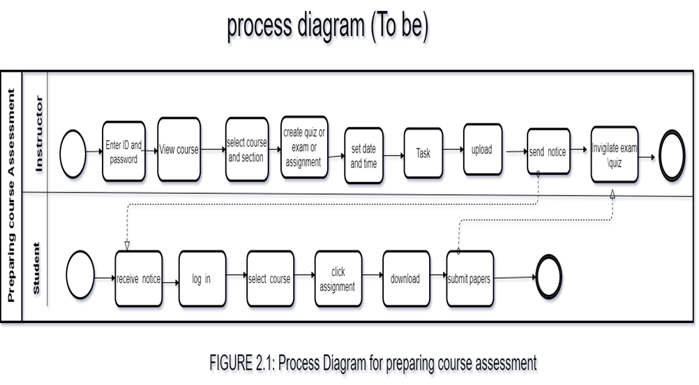

Slide 55
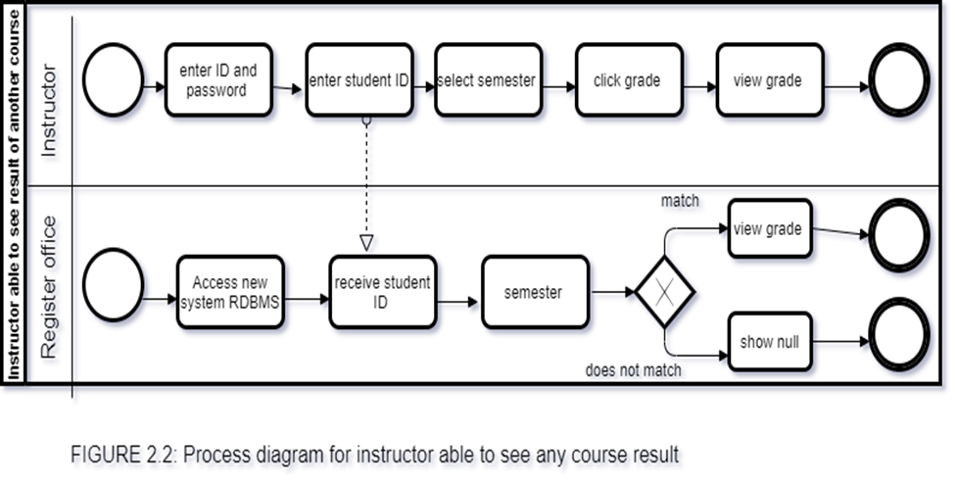

Slide 56
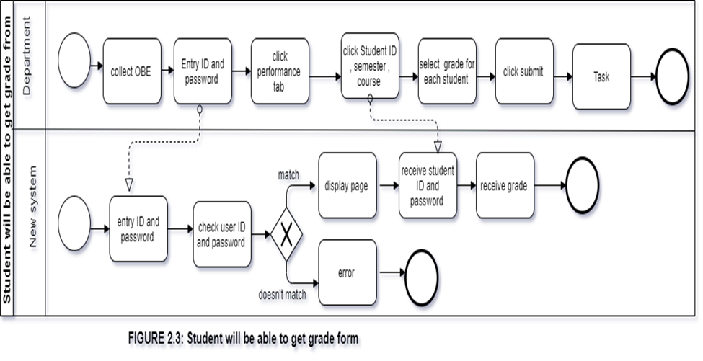

Slide 57
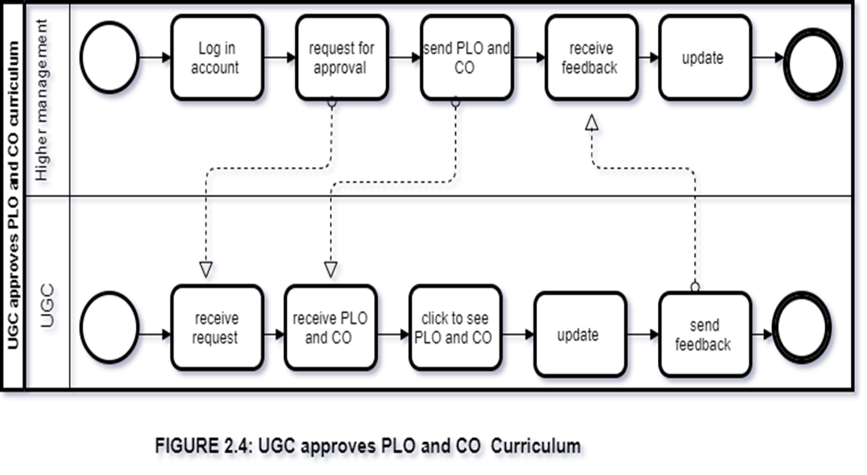

Slide 58
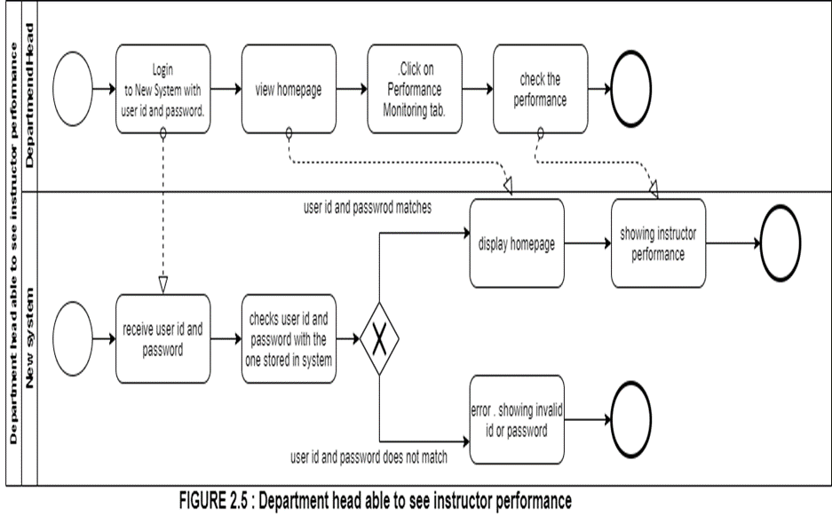

Slide 59
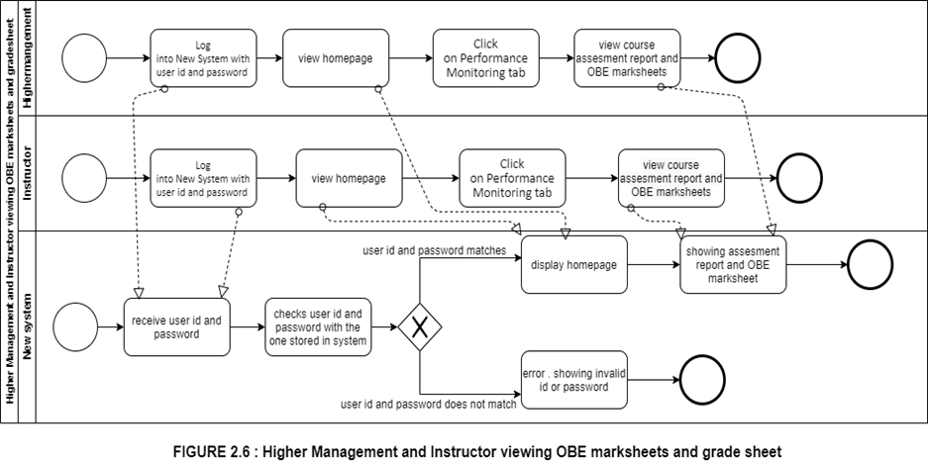

Slide 60
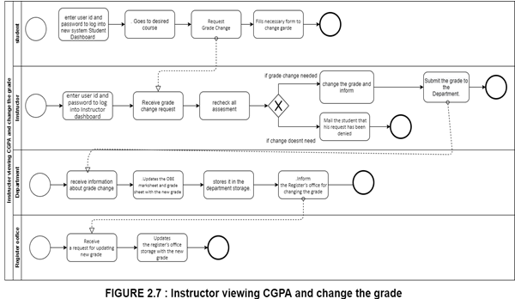

Slide 61
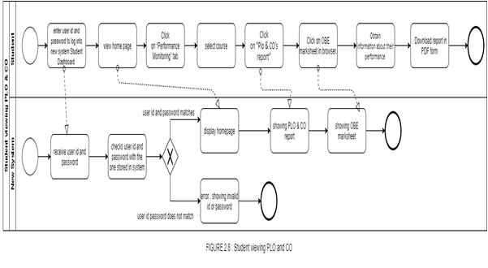
FIGURE 2.8 Student viewing PLO &CO

Slide 62
BUSINESS RULE
1) A student may register under one or more programs. A program many have multiple students.
2) A department may have multiple programs. A program must be exactly under one department.
3) A school may have multiple departments. A department must be exactly under one school.
4) A department may have multiple instructors. An instructor must be exactly under one department.
5) A department must have exactly one head.
6) A school must have exactly one dean.
7) A program may have multiple PLOs. A PLO many be under multiple programs.
8) An instructor may teach multiple courses. A course must have exactly one instructor.
9) A course may have multiple sections. A section must be under exactly one course.
10) A student may tale multiple assessments. A particular assessment must be taken exactly by one student.
11) A section may have multiple assessments. An assessment must have one exact section.

Slide 63
ERD

Slide 64
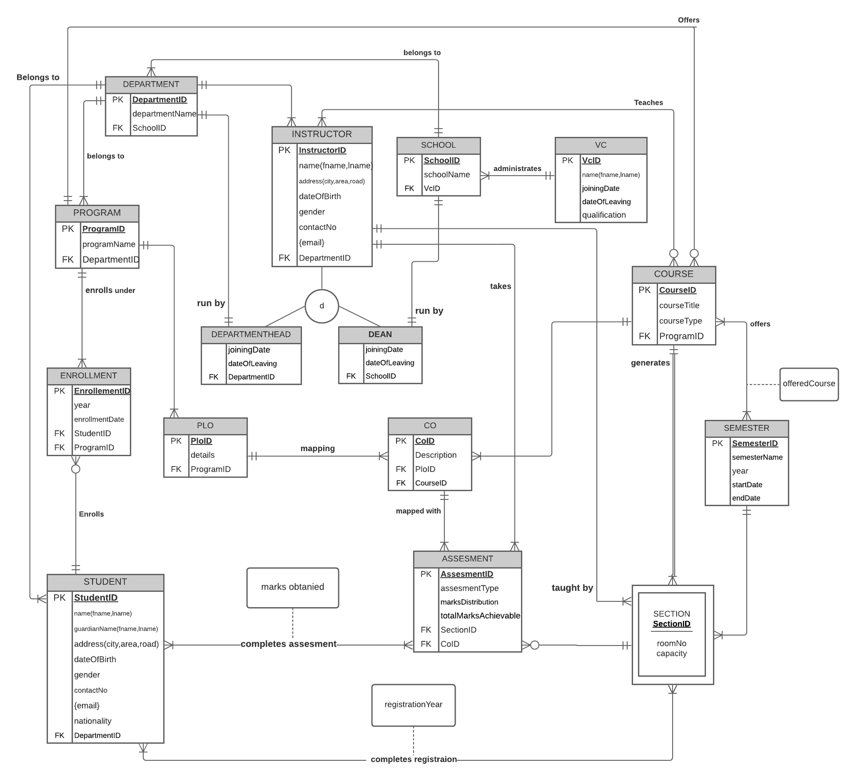
ENTITY RELATIONSHIP DIAGRAM

Slide 65
ENTITY RELATIONSHIP DIAGRAM TO RELATIONAL SCHEMA

Slide 66
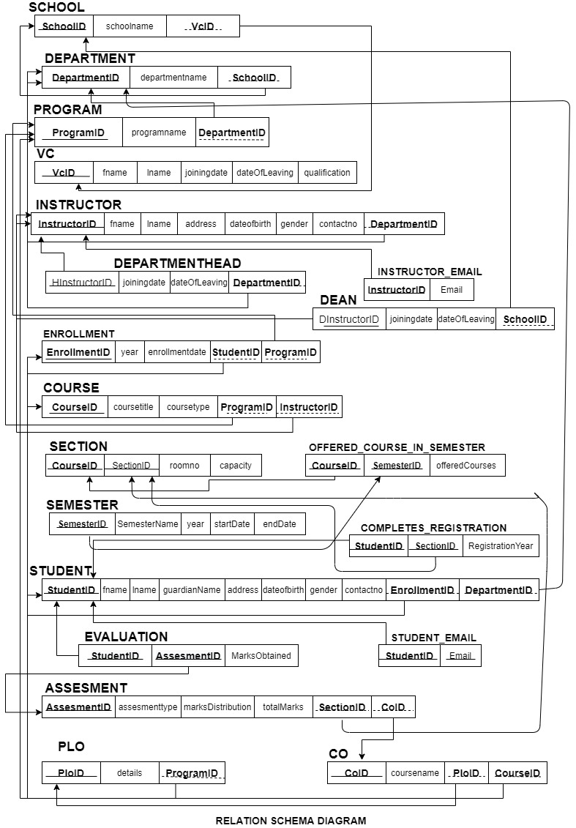

Slide 67
NORMALIZATION

Slide 68
NORMALIZATION
School | SchoolID | s1 | Enrollment | enrollemntID | n1
 |  |  |  | year | n2
 | School name | s2 |  | Enrollment date | n3
 | VCID | v1 |  | studentID | t1
 |  |  |  | ProgramID | p1
VC | vcID | v1 | student | studentID | t1
 | Fname | v2 |  | fname | t2
 | Iname | v3 |  | iname | t3
 | Joining datew | v4 |  | City | t4
 | Leaving date | v5 |  | Road | t5
 | Qualification | v6 |  | Area | t6
Department | departmentID | d1 |  | Date of birth | t7
 | Departmentname | d2 |  | Gender | t8
 |  |  |  | Contact no | t9
 | schoolID | S1 |  | Nationality | t10
program | programID | p1 |  | enrollmentID | n1
 | Program name | p2 |  | departmentID | d1
 | departmentID | d1 | Assessment | Assessment ID | a1
Instructor | InstructorID | i1 |  | Assessment type | a2
 | fname | i2 |  | Marks distribution | a3
 | Iname | i3 |  | sectionNO | e1
 | City | i4 |  | studentID | t1
 | Area | i5 |  | COID | o1
 | Road | i6 |  | PLOID | l1
 | Date of birth | i7 |  | Student complete assessment | a4
 | Gender | i8 |  | Student marks obtained | a5

Slide 69
NORMALIZATION
 |  |  | Course
Department Head | departrmentheadID | h1 |  | Course type | c3
 | qualification | h2 |  | programID | p1
 | Joining date | h3 |  | InstructorID | i1
 | Date of leaving | h4 |  | semesterID | r1
Dean | deanID | x1 | Section | sectionNO | e1
 | Annual salary | x2 |  | courseID | c1
 | Joining date | x3 |  | Room no | e2
 | Date of leaving | x4 |  | capacity | e3
 |  |  |  | Start time | e4
 |  |  |  | End time | e5
PLO | PLOID | l1 | Semester | SemesterID | r1
 | Details | l2 |  | year | r2
 | programID | p1 |  | Start date | r3
CO | COID | o1 |  | End date | r4
 | Course name | o2
 | PLOID | l1

Slide 70
NORMALIZATION
s1-> | s 2, v1
v1-> | v2,v3,v4,v5,v6
d1-> | d2,s1
p1-> | p2,d1
i1-> | i2,i3,i4,i5,i6,i7,i8,i9,d1
i1,h1-> | h2,h3,h4
i1,x1-> | x2,x3,x4
n1-> | n2,n3,t1,p1
t1-> | t2,t3,t4,t5,t6,t7,t8,t9,t10,n1,d1
a1-> | a2,a2,a3,a4,a4,e1,t1,o1,l1
c1-> | c2,c3,p1,i1,r1
e1-> | e2,e3,e4,c1
l1-> | l2,p1
o1-> | o2,l1
r1-> | r2,r3,r4

Slide 71
NORMALIZATION
SchoolID-> | School name, VCID
vcID -> | Fname,iname, Joining date, Leaving date, Qualification
departmentID -> | Department name, schoolID
ProgramID-> | Program name , departmentID
Instructor ID-> | Fname, iname, city, area, road, date of birth, gender , contact no (gmail), departmentID
Instructor Deartment HeadID-> | Qualification , joining date , date of leaving
Instructor DeanID-> | Annual salary, joining date ,date of leaving
enrollmentID-> | Year, enrollment date, studentID, programID
studentID-> | Fname,iname,city,road,area,date of birth,gender , contact no(gmail),nationality , enrollmentID, departmentID
Assessment > | Assessment type, marks distribution, sectionNO,, studentID, COID ,PLOID, student complete assessment , student marks distribution
courseID-> | Course title, course type, programID, intructorID, semesterID
sectionNO-> | courseID, room no, capacity , start time
PLOID-> | Details, programID
CO-> | Course name , PLOID
SemesterID-> | Year, start time, end date

Slide 72
NORMALIZATION
1NF
If a relation that has a primary key and in which there are no repeating groups will be 1nf.
But our functional dependency table and relation have repeating groups and a primary key has not defined so the relation not will be 1nf.

Slide 73
NORMALIZATION
2NF
If a relation in first normal form in which every non key attribute is fully functionally dependent on the primary key and a functional dependency in which one or more non key attributes are functionally dependent on part of the primary key that’s time relation will be 2NF
But our relation not fully dependent on primary key and functional dependency have not any non-key attributes are not functionally dependent on primary key. This relation not also 1NF. There are no composite keys present this step is not required.
So the relation not will be 2NF.

Slide 74
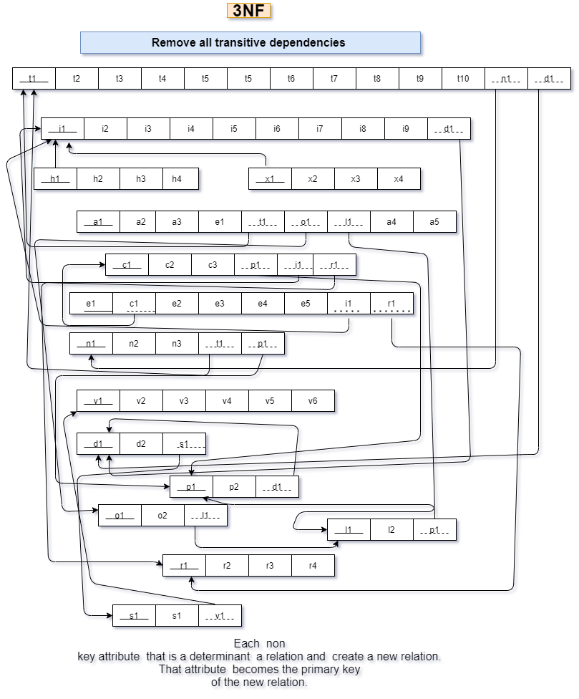
NORMALIZATION
3NF

Slide 75
NORMALIZATION
BCNF
Relation which every determinant is a candidate key is said to be in BCNF.
Each and every functional dependency relation have candidate key and candidate key identify non key attribute. This relation has not non-key attribute can identify primary key.
So all relation in a BCNF.

Slide 76
DATA DICTONARY

Slide 77
VC_T
Name | DataType | Size | Remark
nvcid | Number | 7 | This is the Primary Key for VC. Example: “19*****”
cname | Text |  | This is the name of vc Example: “md khan”
djoiningDate | DateTime |  | This contains the date when vc took charge of his role . Example : “01.01.2015
dleavingDate | DateTime |  | This contains the date when vc discharged from his role Example : “01.01.2020
cqualification | Text |  | This contains the qualification of vc Example “ PHD , BSC”

Slide 78
School_T
Name | DataType | Size | Remark
cschoolid | Text | 5 | This is the Primary Key of School Example: “SETS”
Cschoolname | Text |  | This is the name of the School. Example: “School of Engineering, Technology and Science”
nvcid | Number |  | This is the foreign key from the VC table . Example : “19*****. “

Slide 79
Department_T
Name | DataType | Size | Remark
cdepartmentid | Text |  | This is the Primary Key of the Department. Example: “EEE”
cdepartmentname | Text |  | This is the name of the Department. Example: “Computer Science and Engineering”
cschoolid | Text |  | This is the Foreign Key of the table School. Example: “SETS”

Slide 80
Student_T
Name | DataType | Size | Remark
nstudentid | Number |  | This is the Primary Key for the Student. Example: “1800001”
cname | Text |  | This is the name of the Student. Example: “Muhammad Akib”
cguardianname | Text |  | This is the name of the guardian. Example: “Muhammad karim”
caddress | Text |  | This is the address of the Student. Example: “House 270, Road 6, Block C, Bashundhara, Dhaka, Bangladesh
ddateofbirth | Datetime | “dd/mm/yy” | This the Date of Birth of the Student. Example: “01-01-2000”
cgender | Text |  | This is the gender of the Student. Example: “M”
ncontactno | Number |  | This is the phone number of the Student. Example: “0191211141”
cemail | Text |  | This is the email address of the Faculty. Example: “mahady@iub.edu.bd”
cnationality | Text |  | This contains nationality of the student Example: “Bangladeshi”
ndepartmentid | Number |  | This is the Foreign Key from the Department table. Example: “CSE

Slide 81
Instructor_T
Name | DataType | Size | Remark
ninstructorID | Number |  | This is the Primary Key for Faculty. Example: “1501*** “
cname | Text |  | This is the first name of the instructor. Example : “ Abdur Rahim”
caddress | Text |  | This is the address of the instructor. Example: “House 1, Road 1, Sector 1, Uttara, Dhaka, Bangladesh
ddateofbirth | DateTime | DD-MM-Y YYY | This the Date of Birth of the instructor. Example: “01-01-1993”
cgender | Text |  | This is the gender of the instructor . Example: “F”
ncontactno | Number |  | This is the phone number of the instructor. Example: “01910101010”
cemail | Text |  | This is the email address of the instructor. Example: “rakib@iub.edu.bd”
cdepartmendid | Text |  | This is the Foreign Key from the Department table. Example: “CSE”

Slide 82
PLO_T
Departmenthead_T
Name | DataType | Size | Remark
djoiningDate | DateTime |  | This contains the date when a department head took charge of his role Example : “01.01.2015”
dleavingDate | DateTime |  | This contains the date when a department head discharged from his role Example : “01.01.2020”
cdepartmentID | Text |  | This is the Foreign Key from the Department table. Example: “CSE”

Slide 83
Dean_T
Name | DataType | Size | Remark
djoiningDate | DateTime |  | This contains the date when a Dean took charge of his role Example : “01.01.2015”
dleavingDate | DateTime |  | This contains the date when a Dean discharged from his role. Example : “01.01.2020”
cschoolid | Text |  | This is the Foreign Key of the table School. Example: “SETS”

Slide 84
PLO_T
Name | DataType | Size | Remark
cploid | Text | 5 | This is the primary key for Program Learning Outcome. Example: “PLO1”
cdetails | Text |  | This is the details of the Program Learning Outcome. Example: “An ability to select and apply the knowledge, techniques, skills, and modern tools of the computer science and engineering discipline”
cporgramid | Text |  | This is the foreign key from Program table Example: ”B.Sc”.

Slide 85
CO_T
Name | DataType | Size | Remark
ccoid | Text | 5 | This is the Primary Key for Course Outcome. Example: “CO1”
ccoursename | Text |  | This is the name of the course Example: “Database management system”
cploid | Text |  | This is the foreign key from the Program Learning Outcome table. Example: “PLO1”
ccourseid | Text |  | This is the foreign key from the course table . Example: “CSE203”

Slide 86
Enrollment_T
Name | DataType | Size | Remark
nenrollmentid | Number |  | This is the Primary Key for Enrollment Example :”1”
dyear | Datetime |  | This is the year of Enrollment Example: “2017”
denrollmntdate | DateTime | DD-MM-Y YYY | This contains the date of the enrollment. Example : 30/01/2021
nstudentid | Number |  | This is the Foreign key from the Student Table. Example: “1800001”
cprogramid | Text |  | This is the Foreign Key from Program table Example: ”B.Sc”.

Slide 87
Program_T
Name | DataType | Size | Remark
cprogramid | Text |  | This is the Primary Key for program. Example : “BSC”
cprogramname | Text |  | This is the name of the program . Example : “Bachelor of Science”
cdepartmentid | Text |  | This is the Foreign Key from the Department table. Example: “CSE”

Slide 88
Course_T
Name | DataType | Size | Remark
ccourseid | Text |  | This is the Primary Key for the Course. Example: “CSE203”
ccoursetitle | Text |  | This is the name of the Course. Example: ”Data Structure”
ccoursetype | Text |  | This is the type of the Course. Example: “Core”
cprogramid | Text |  | This is the Foreign Key from Program table Example: ”B.Sc”.

Slide 89
Section_T
Name | DataType | Size | Remark
nsectionID | Number |  | This is the Primary Key for Section Example :”2"
croomno | Text |  | This is the room number of a section. Example: “B1101”
ncapacity | Number |  | This is the total capacity of a section . Example :”50”

Slide 90
Assessment_T
Name | DataType | Size | Remark
nassessmentID | Number |  | This is the Primary Key for assessment . Example : “1”
cassessmenttype | Text |  | This is the type of assessment . Example : “Assignment ,Viva”
cmarksdistribution | Text |  | This contains the marks distribution.
Ctotalmarksachievable | Text |  | This contains how much mark a student can achieve in total . Example : “100”
nsectionid | Number |  | This is the foreign key from section table Example” 1001”
ccoid | Text |  | This is the foreign key from the Program Learning Outcome table. Example: “CO1”

Slide 91
Semester_T
Name | DataType | Size | Remark
nSemesterid | Number |  | This is the Primary Key for semester Example:1
nSemesterName | Text |  | This is the name of the semester Example: “Fall”
dyear | DateTime |  | This contains the year of that semester . Example :” 2021”
dstartdate | DateTime |  | This is the starting date of the semester . Example : “15.02.21”
denddate | DateTime |  | This is the ending date of the semester . Example : “10.05.21”

Slide 92
INPUT FORMS OUTPUT TABLE & GRAPHS

Slide 93
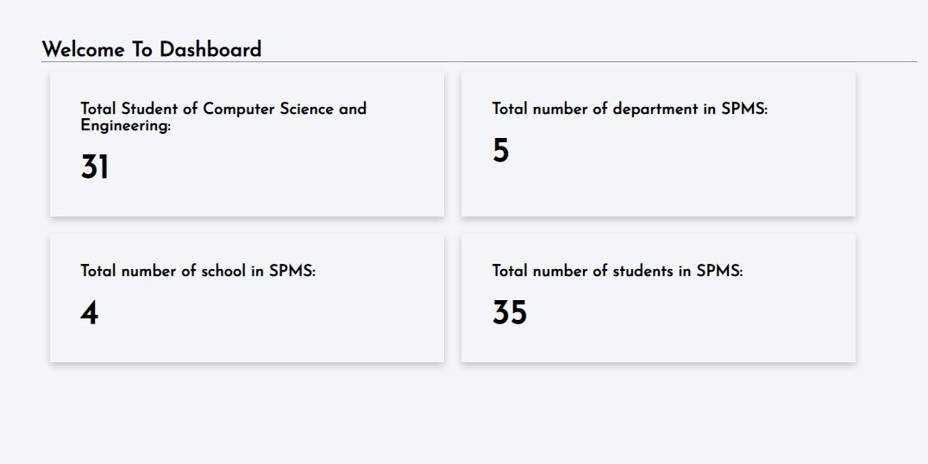
DASHBOARD

Slide 94
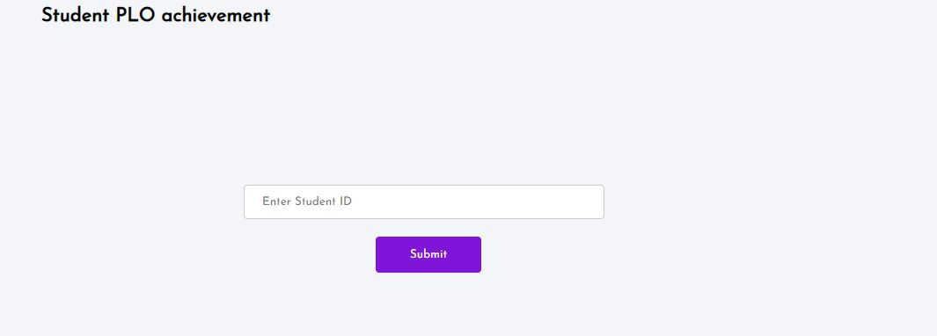
STUDENT PLO ACHIEVEMENT INPUT FORM

Slide 95
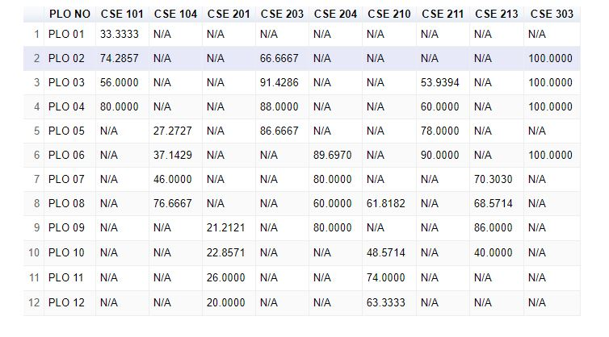
COURSE WISE PLO ACCHIEVEMENT TABLE

Slide 96
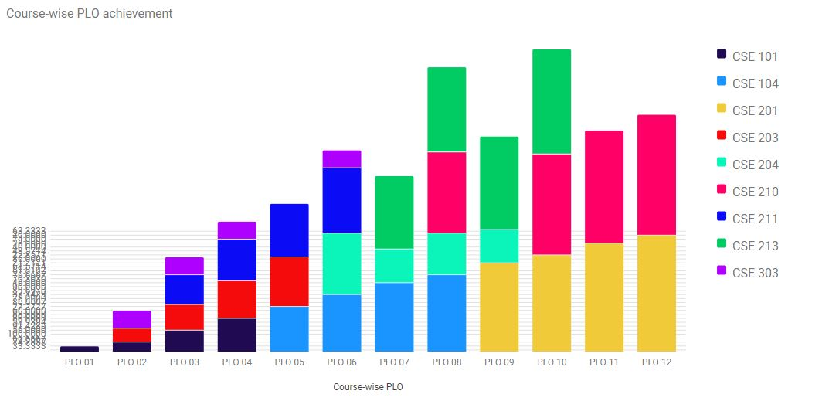
COURSE WISE PLO ACCHIEVEMENT

Slide 97
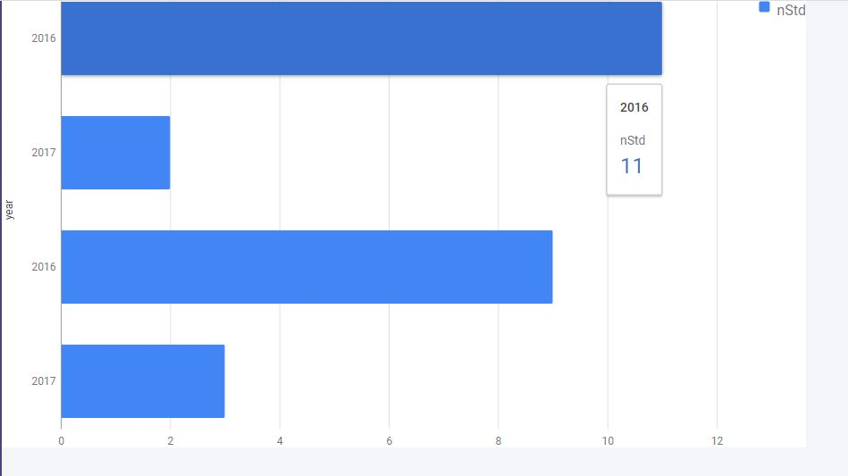
PROGRAM WISE STUDENT ENROLLMENT

Slide 98
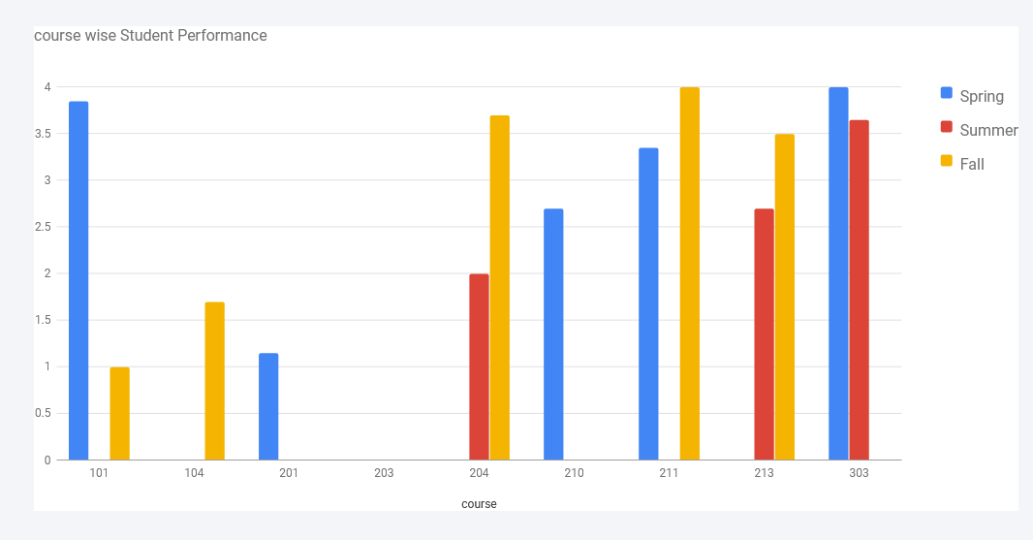
COURSE WISE STUDENT PERFORMANCE

Slide 99
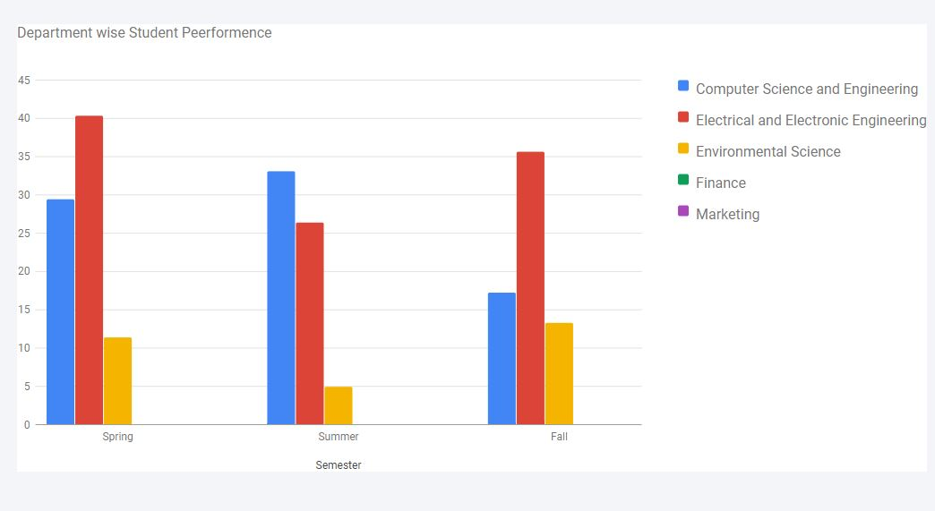
DEPARTMENT WISE STUDENT PERFORMANCE

Slide 100
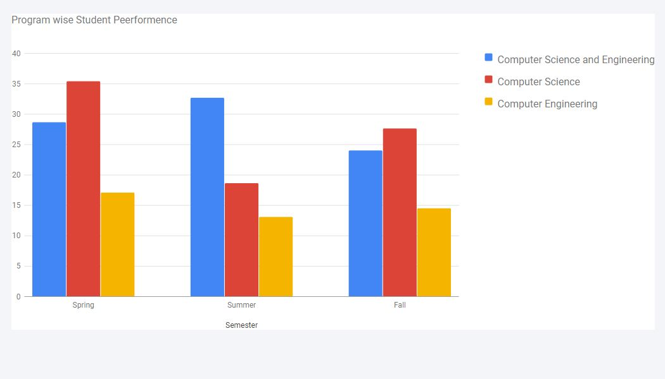
PROGRAM WISE STUDENT PERFORMANCE

Slide 101
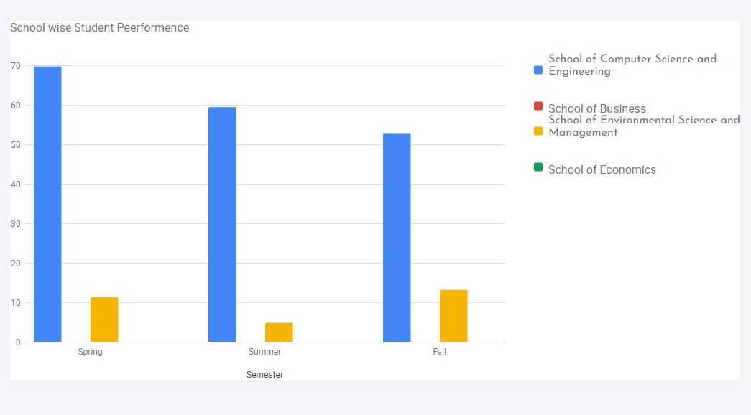
SCHOOL WISE STUDENT PERFORMANCE

Slide 102
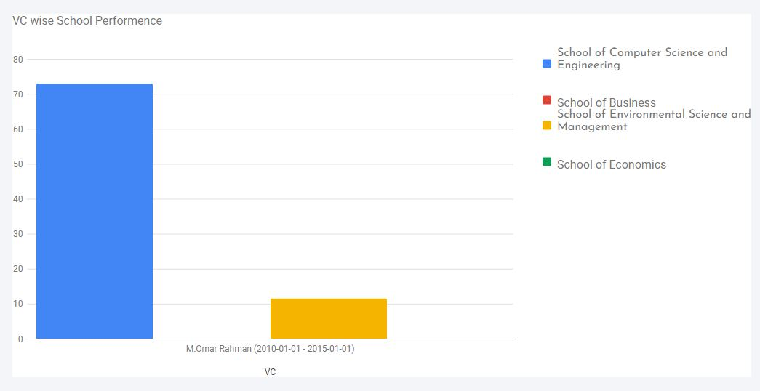
VC WISE SCHOOL PERFORMANCE

Slide 103
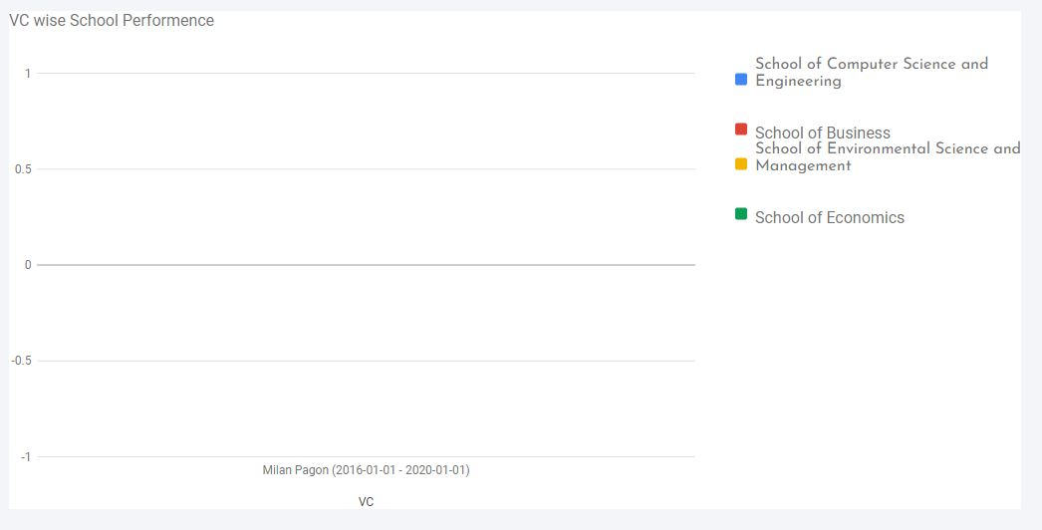
VC WISE SCHOOL PERFORMANCE

Slide 104
THANK YOU

